Slide 1
Music/artist “Hotness”
IST659 Final Project
By: Courtney Smith, Jeremy Wallner, John Fields, Juan Castro

Slide 2


Slide 3
OVERVIEW
The purpose of this project is to analyze the Million Song Database to predict "Hot-Warm-Cold" artists and songs based on the attributes such as familiarity, artist location, loudness, terms used, etc.
The analysis was done using R software on a 10,000 track subset of the data and our model was able to predict "Hot-Warm-Cold" artists with ~80% accuracy and songs with ~50% accuracy.

Slide 4

data

Slide 5
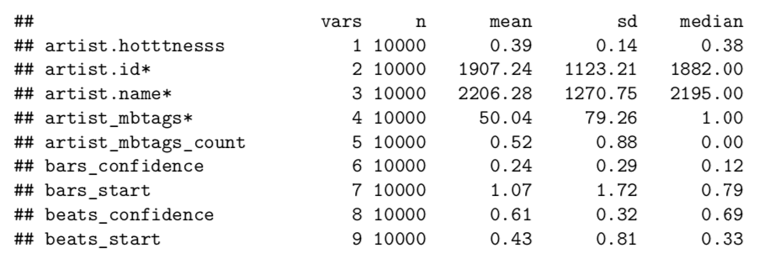
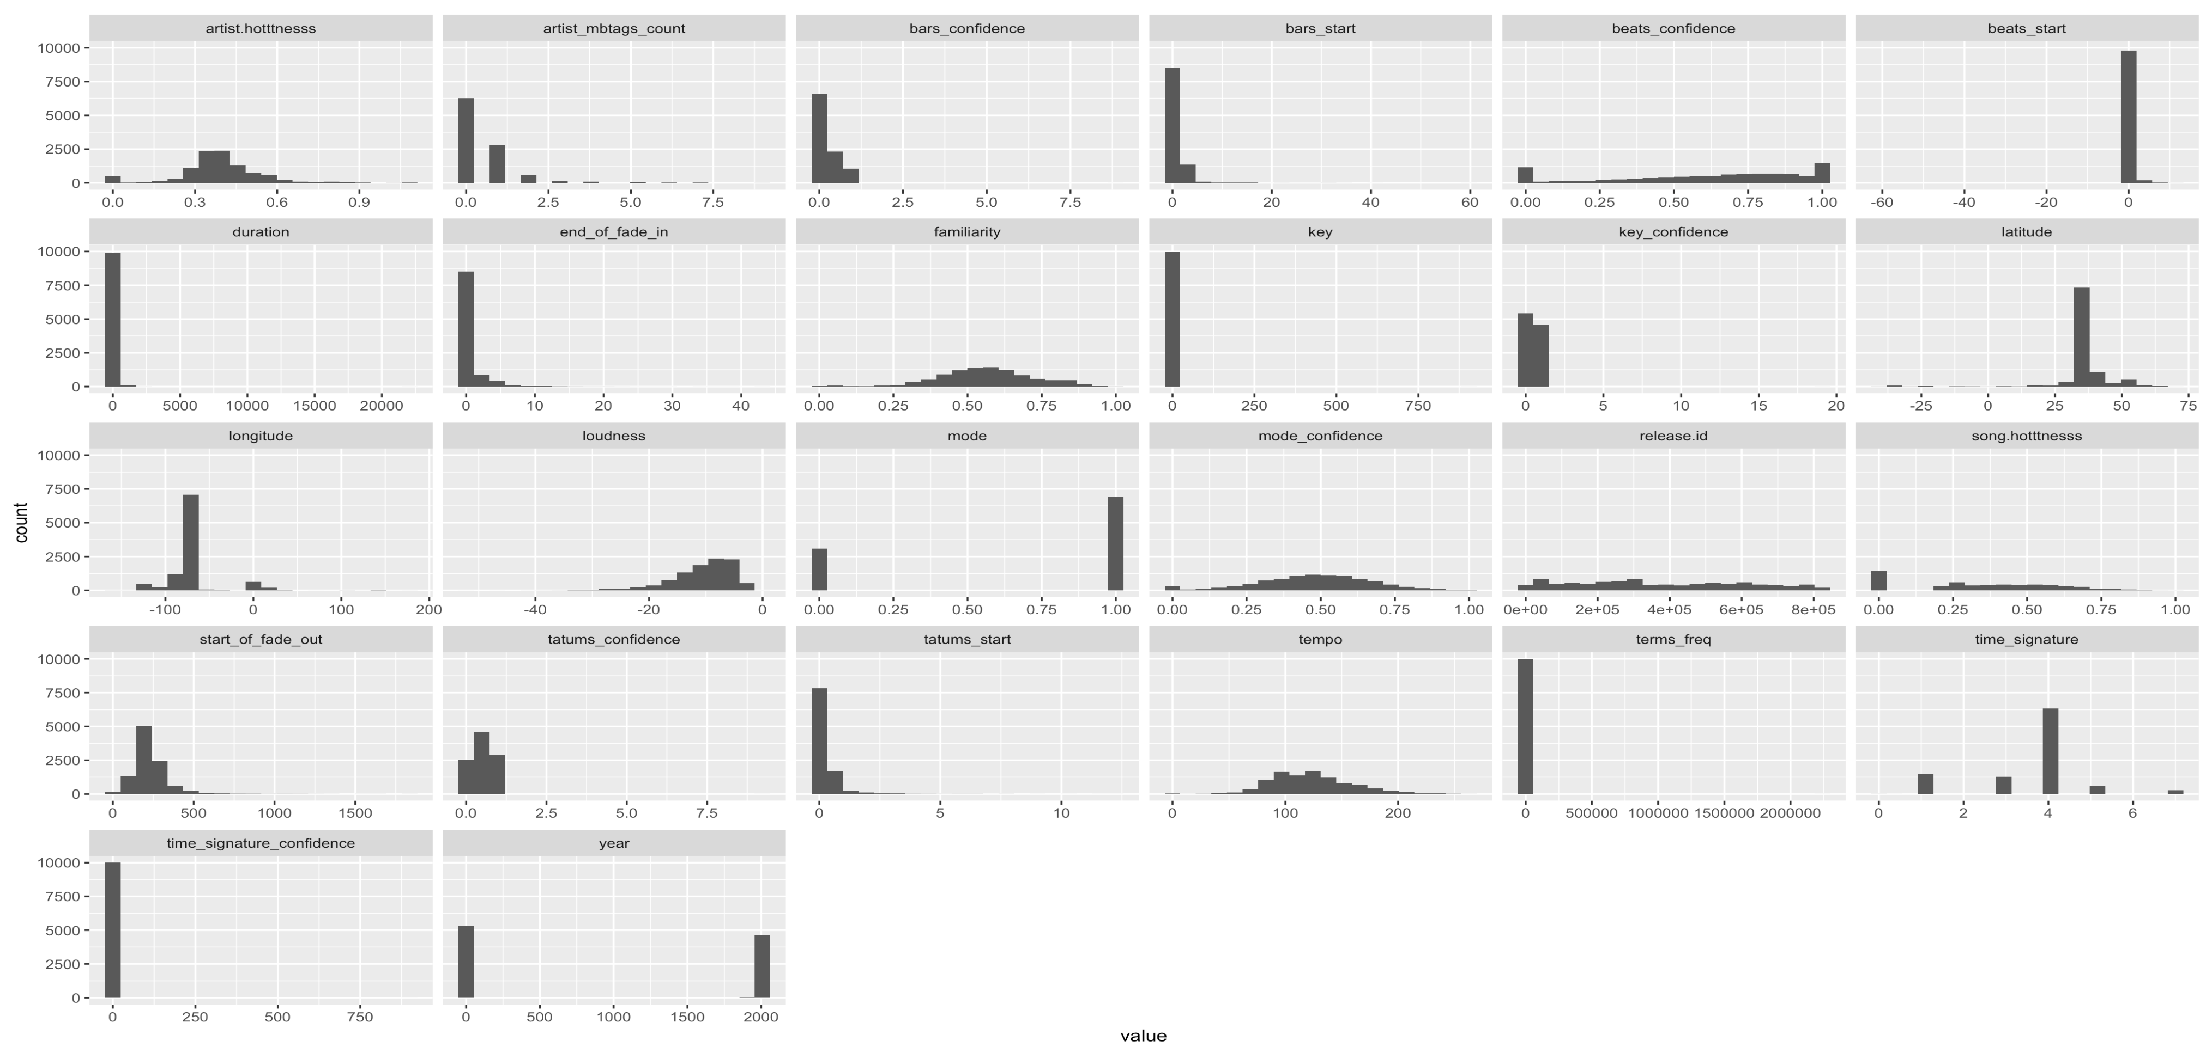
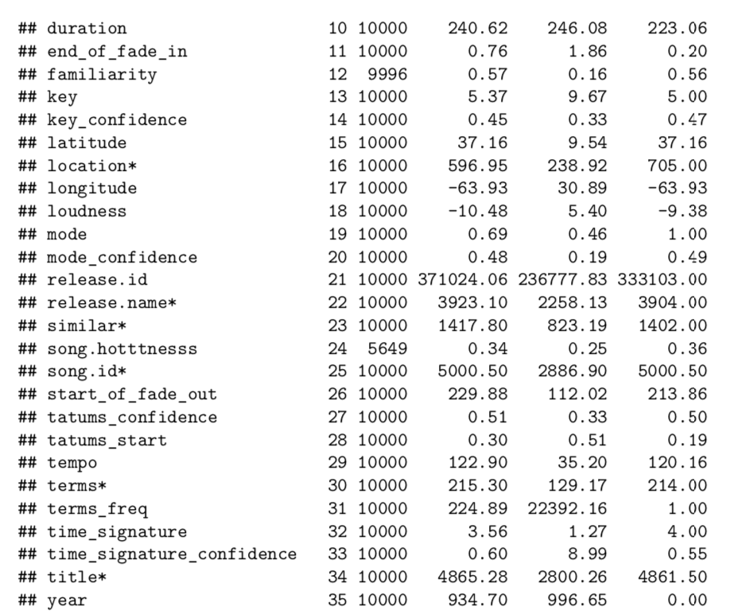
data

Slide 6
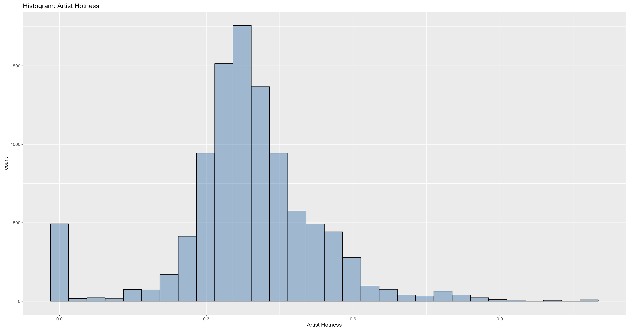
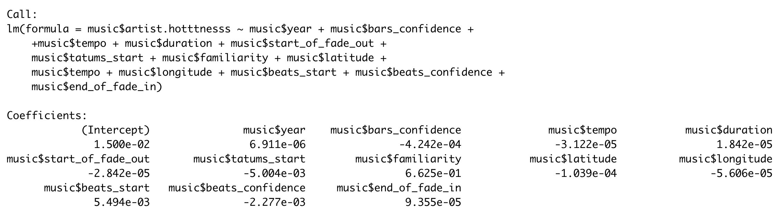
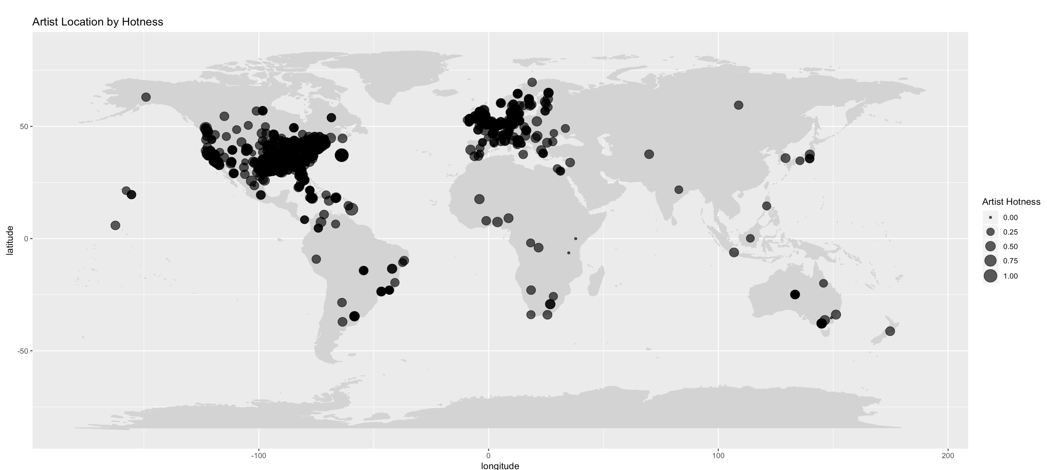
MILLION SONGS DATASET: PREDICTING SONG/TRACK HOTNESS
GOAL
Predict: Will an artist or song be “hot”
Question: What factors make a song popular?
Dataset: Virginia Tech 10K dataset from https://think.cs.vt.edu/
Class labels: 3 or 5 levels of hotness
RESULTS – Artists
RESULTS – Tracks
Best Factors
Artists – Familiarity
Tracks -- Loudness
METHODS
Random Forest
Linear Regression
TOOLS
R libraries – psych, reshape2, dplyr
SQL – data munging the tracks dataset
 | COLD | HOT | WARM | class.error
COLD | 728 | 4 | 448 | 0.3830508
HOT | 6 | 1298 | 284 | 0.1836605
WARM | 200 | 198 | 2491 | 0.1377639
Call:
randomForest(x = music[, -21:-22], y = music[, 21])
Type of random forest: classification
Number of trees: 500
No. of variables tried at each split: 4
OOB estimate of error rate: 20.18%
Confusion matrix:
 | COLD | HOT | WARM | class.error
COLD | xxx | xxx | xxx | xxx
HOT | xxx | xxx | xxx | xxx
WARM | xxx | xxx | xxx | xxx
The lowest P-value for the LM was music$year
LESSONS LEARNED
Data Munging really does take 70-80% of the time for a project!
Using Random Forest we predicted an artist hotness with ~80% accuracy and track hotness with ~50% accuracy

Slide 7

discussion

Slide 8
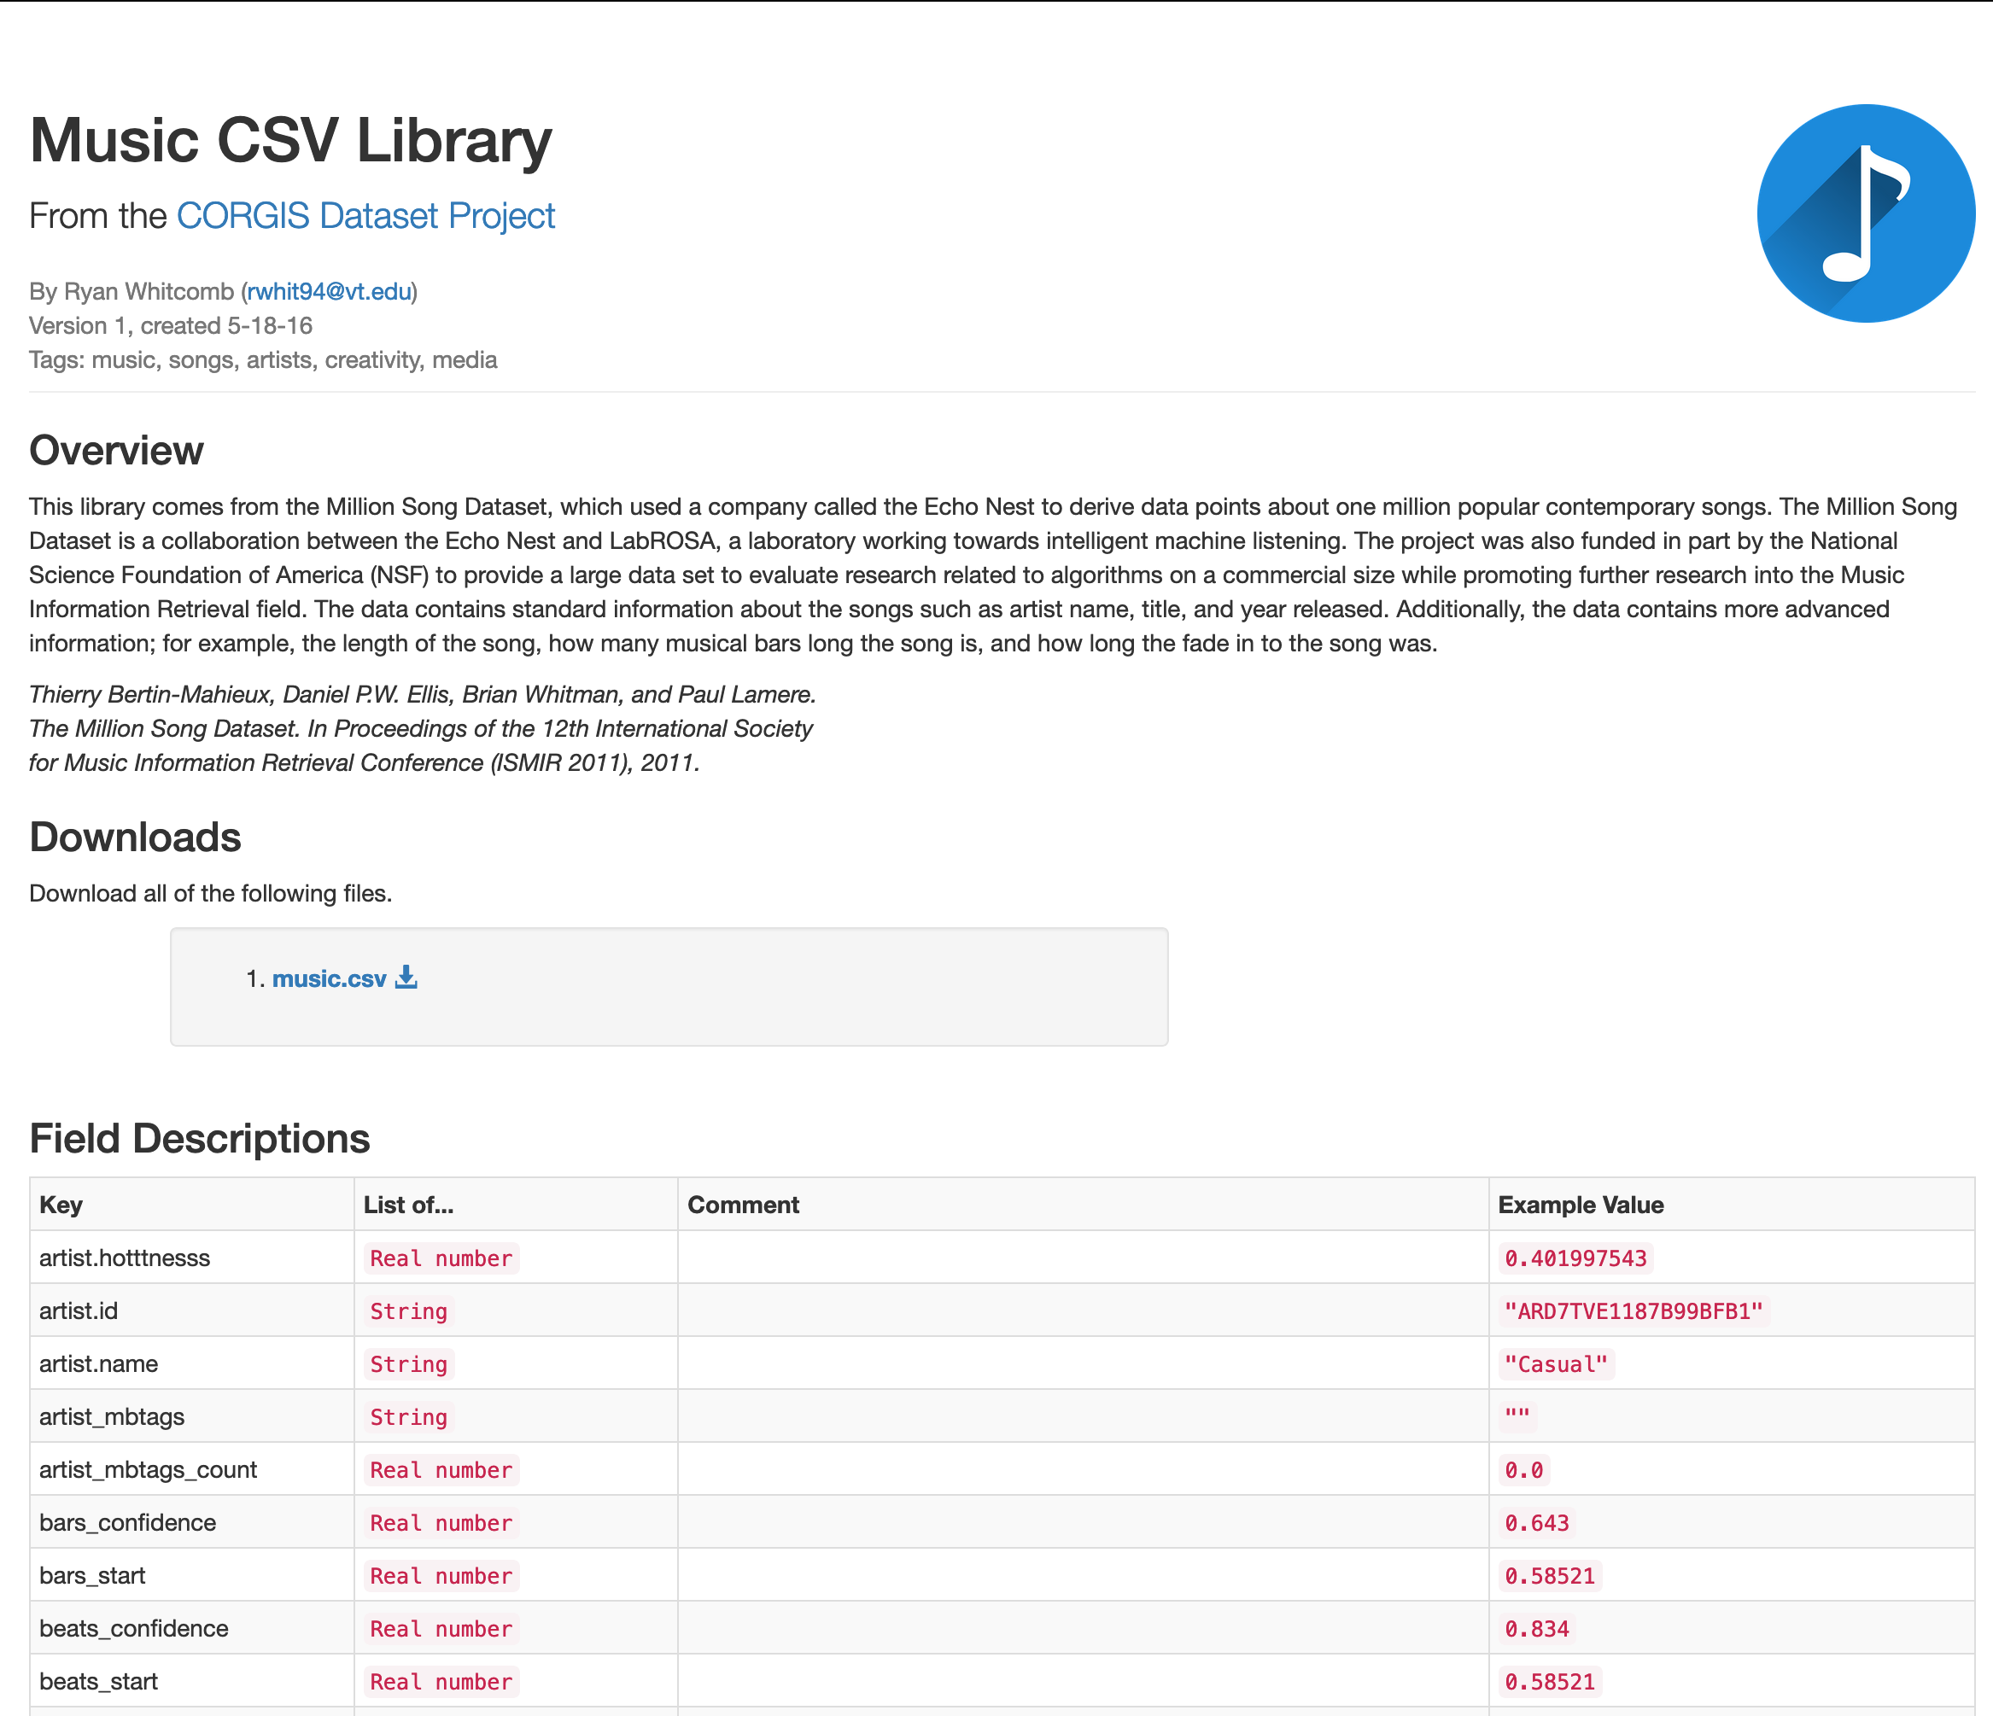
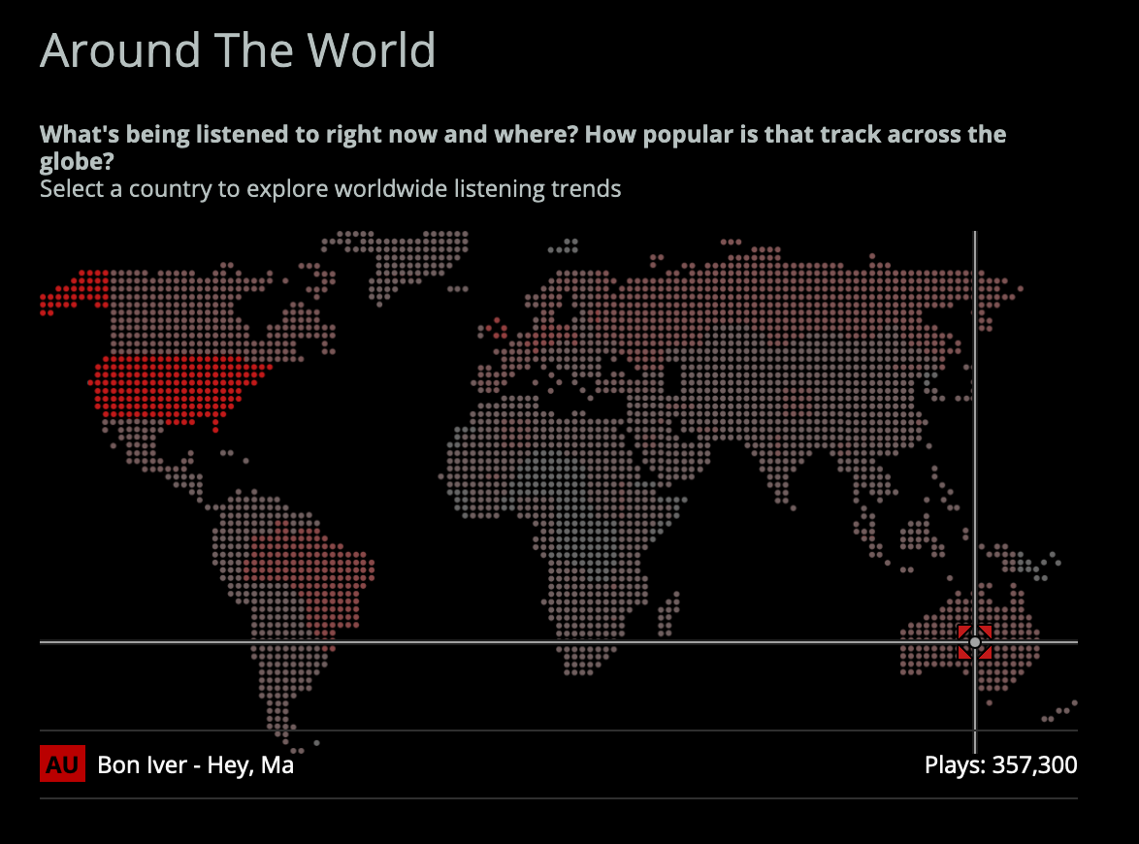
references
Virginia Tech - https://think.cs.vt.edu/corgis/csv/music/music.html
Thierry Bertin-Mahieux, Daniel P.W. Ellis, Brian Whitman, and Paul Lamere. The Million Song Dataset. In Proceedings of the 12th International Society for Music Information Retrieval Conference (ISMIR 2011), 2011.
https://www.last.fm/api
The Last.fm API allows anyone to build their own programs using Last.fm data

Slide 9
Recommended music
John – Claire Ernst, John The Blind, Maggie Rogers, Tom Misch, Tyler Childers
Juan –
Courtney –
Jeremy –
Note: No algorithms were harmed in the development of this list. This is simply music we like. Enjoy!

Slide 10


Slide 11

appendix

Slide 12
ARTIST LOCATION AND HOTNESS

Slide 13
Artist hotness

Slide 14
Artist hotness hot – warm - cold
Call:
randomForest(x = music[, -21:-22], y = music[, 21])
Type of random forest: classification
Number of trees: 500
No. of variables tried at each split: 4
OOB estimate of error rate: 20.18%
Confusion matrix:
 | COLD | HOT | WARM | class.error
COLD | 728 | 4 | 448 | 0.3830508
HOT | 6 | 1298 | 284 | 0.1836605
WARM | 200 | 198 | 2491 | 0.1377639

